Slide 1
Fumdamental Of Operating System

Slide 2
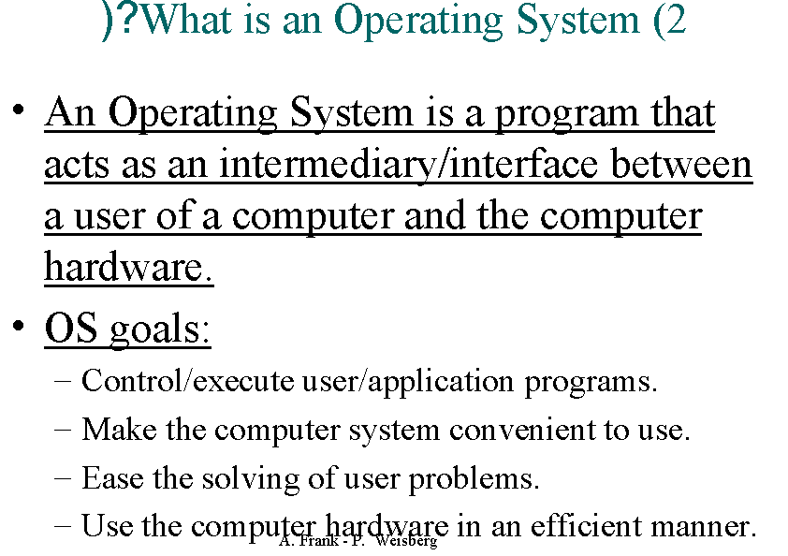

Slide 3
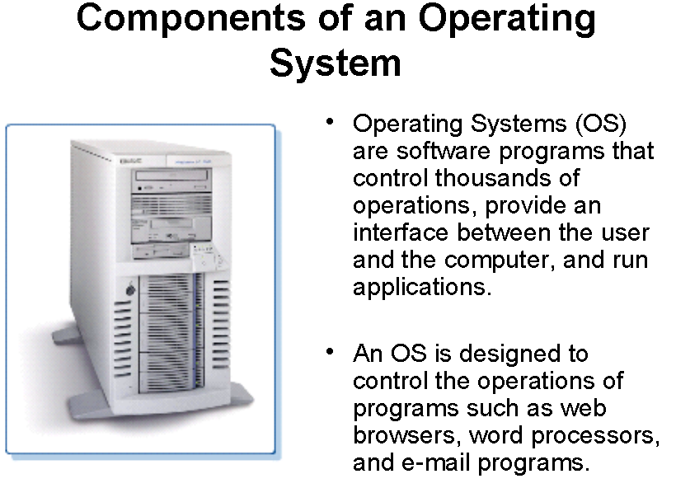

Slide 4
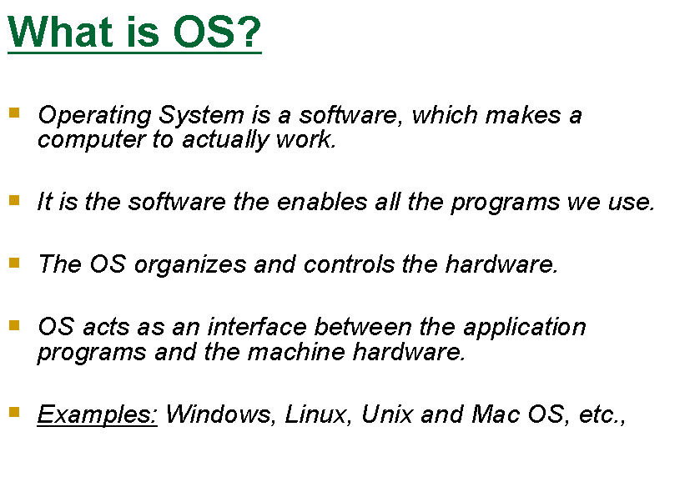

Slide 5
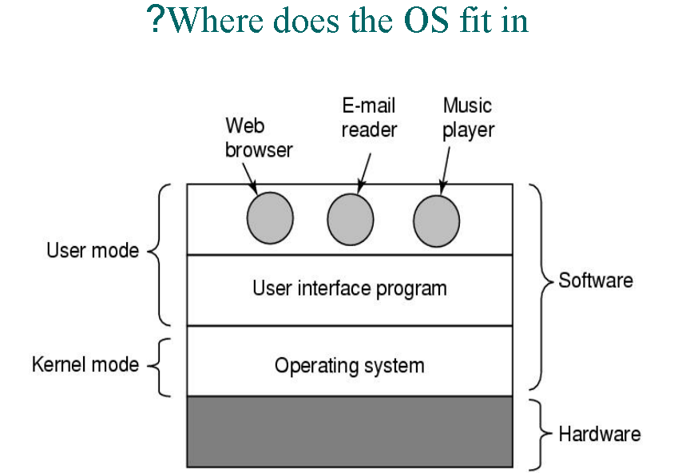

Slide 6
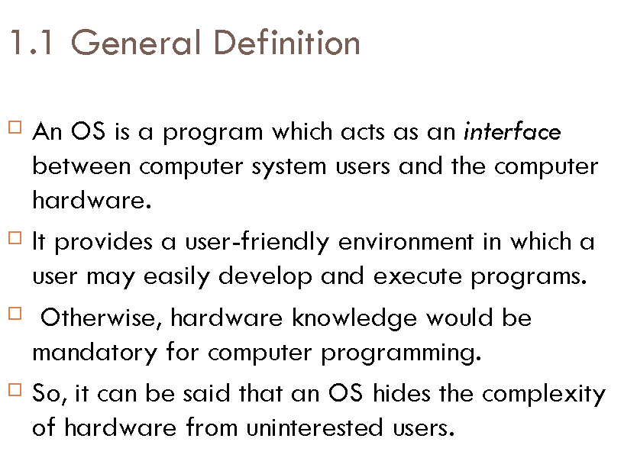

Slide 7
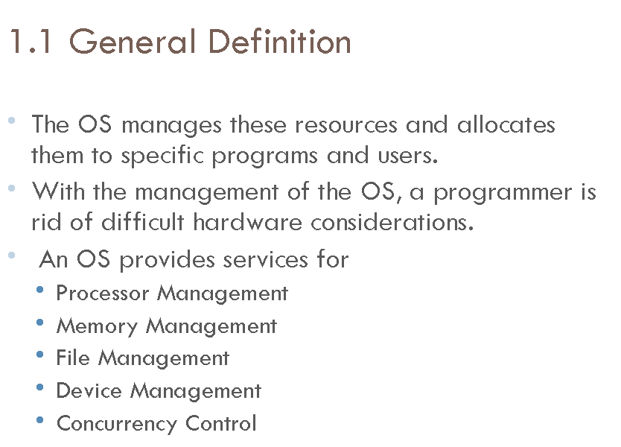

Slide 8
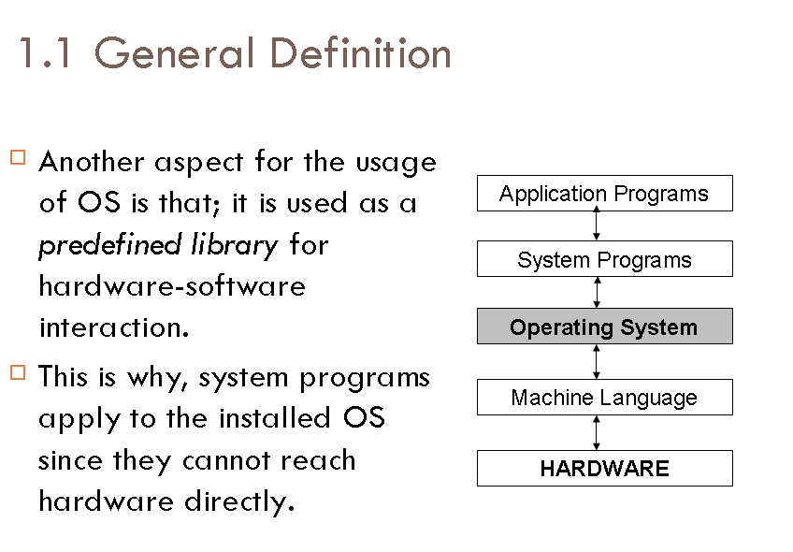

Slide 9
Objectives of Operating System
Convenience
Efficiency
Ability to evolve

Slide 10
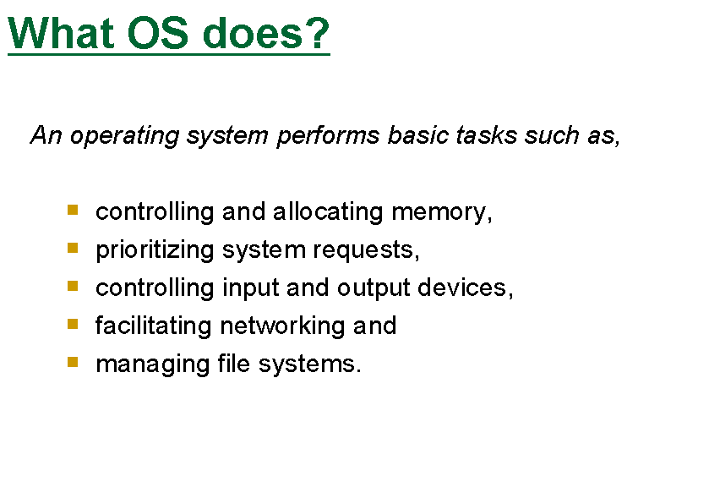

Slide 11
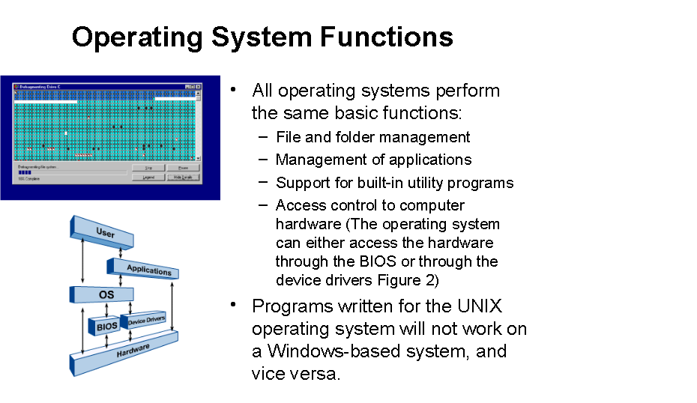

Slide 12
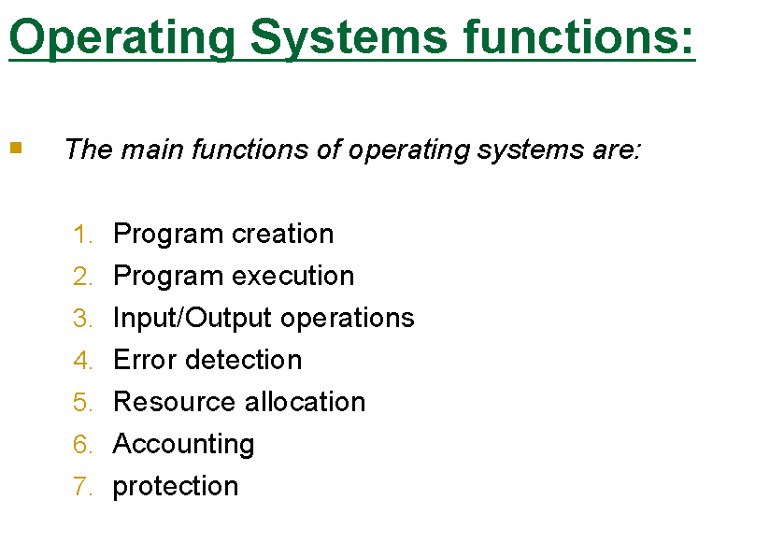

Slide 13
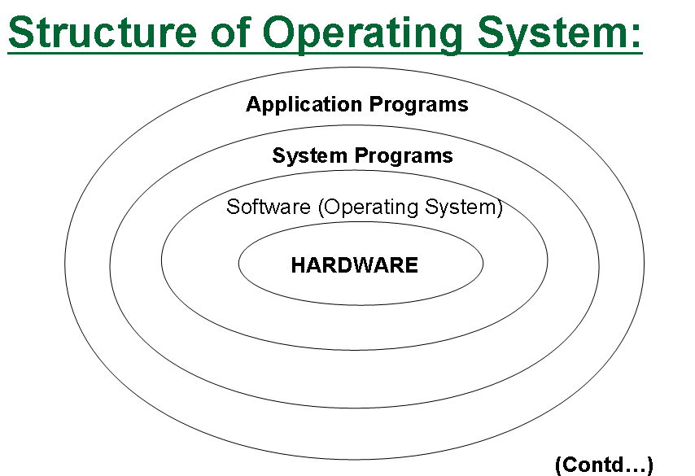

Slide 14
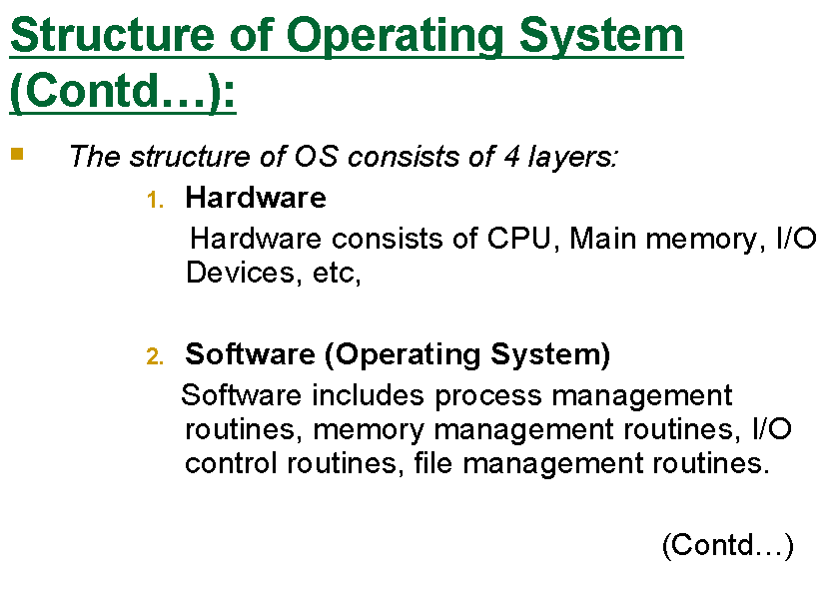

Slide 15
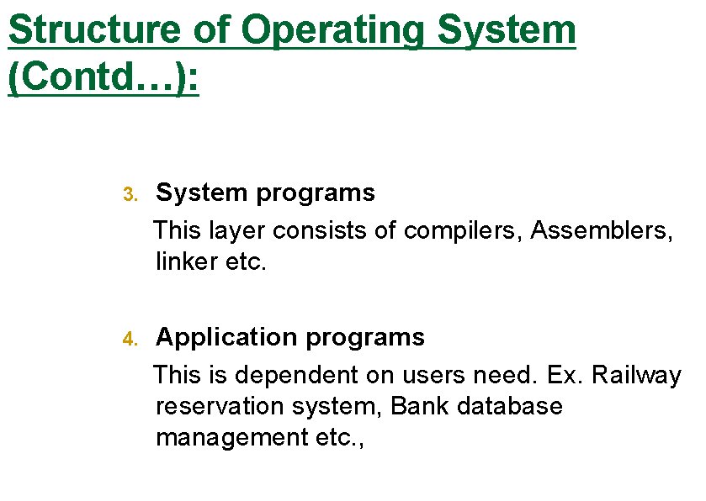

Slide 16
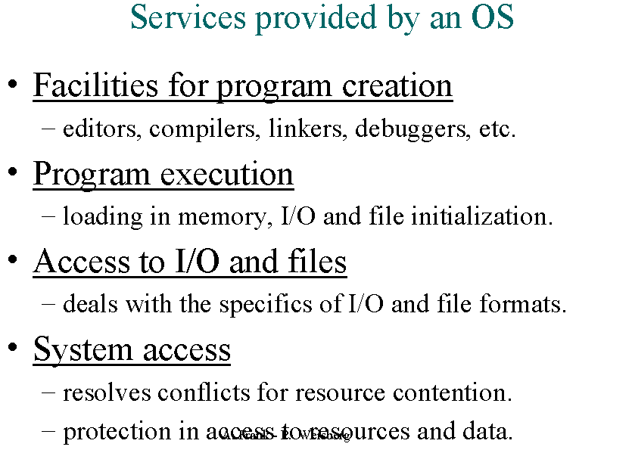

Slide 17
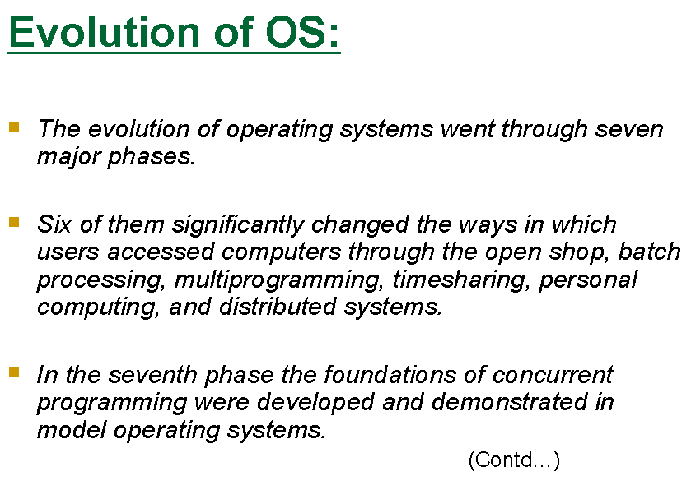

Slide 18
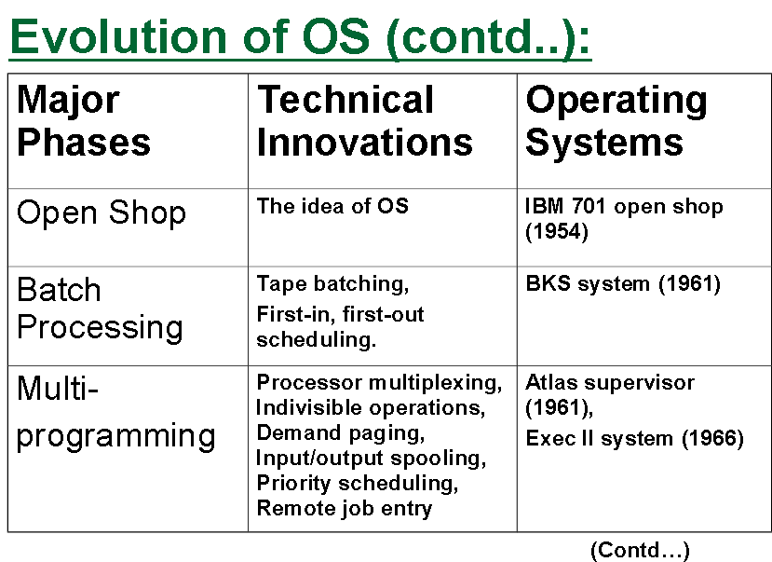

Slide 19
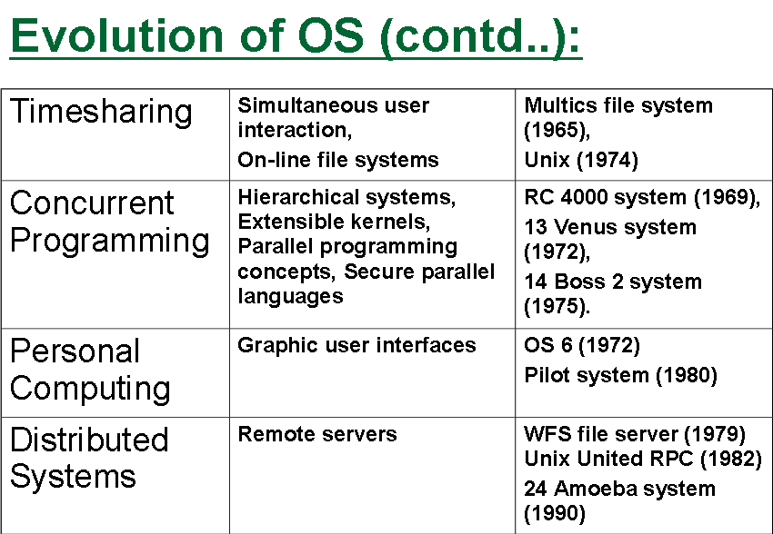

Slide 20
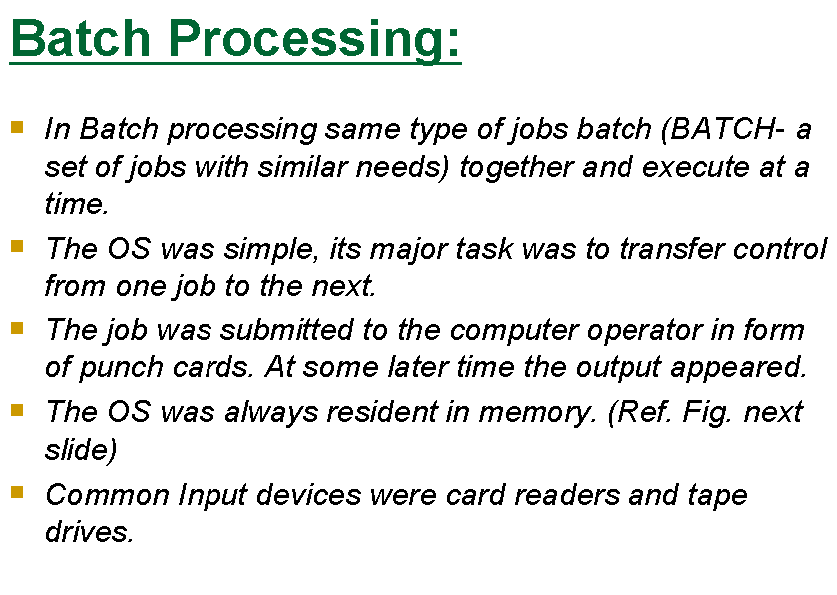

Slide 21
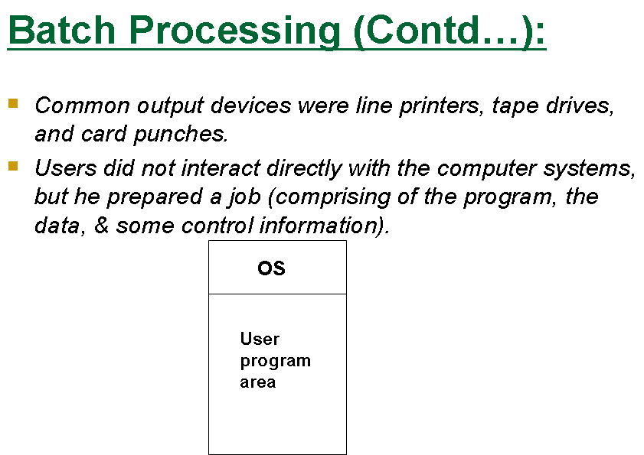

Slide 22
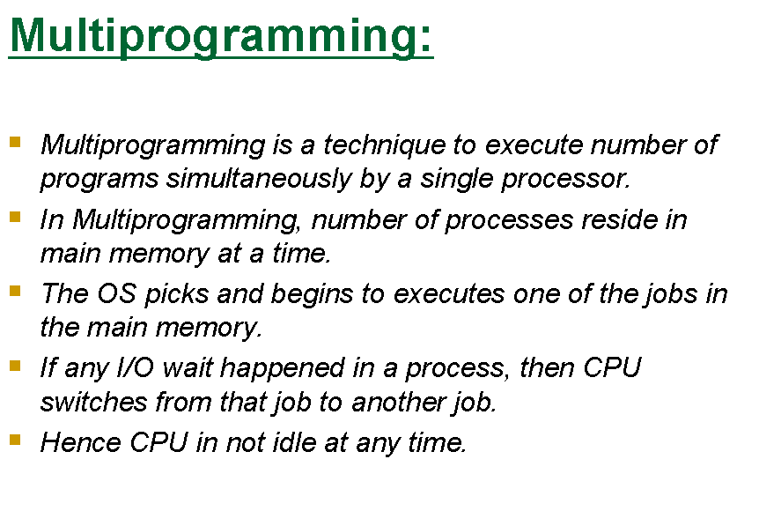

Slide 23
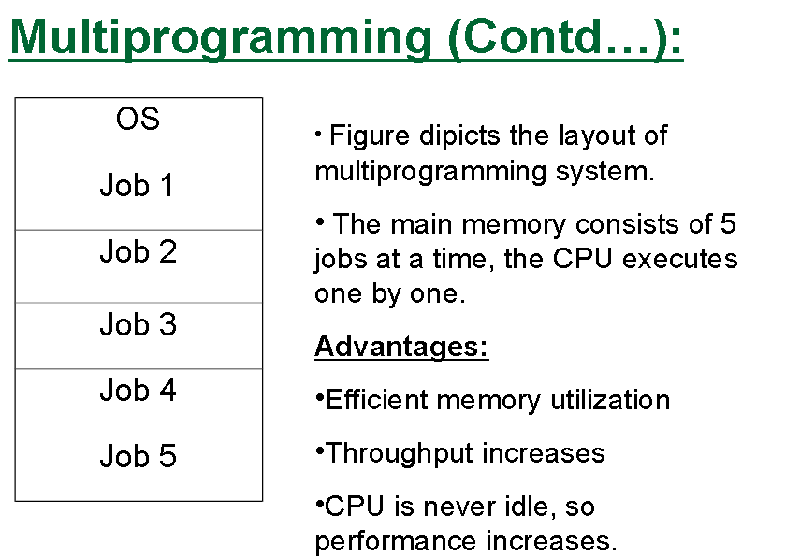

Slide 24
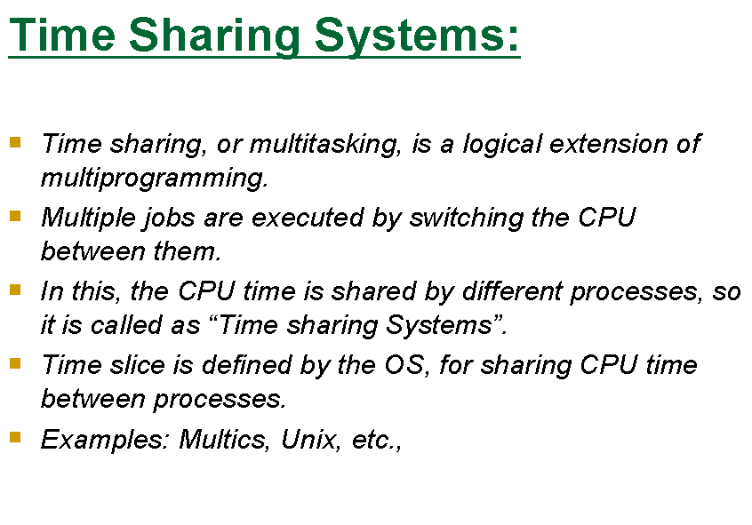

Slide 25
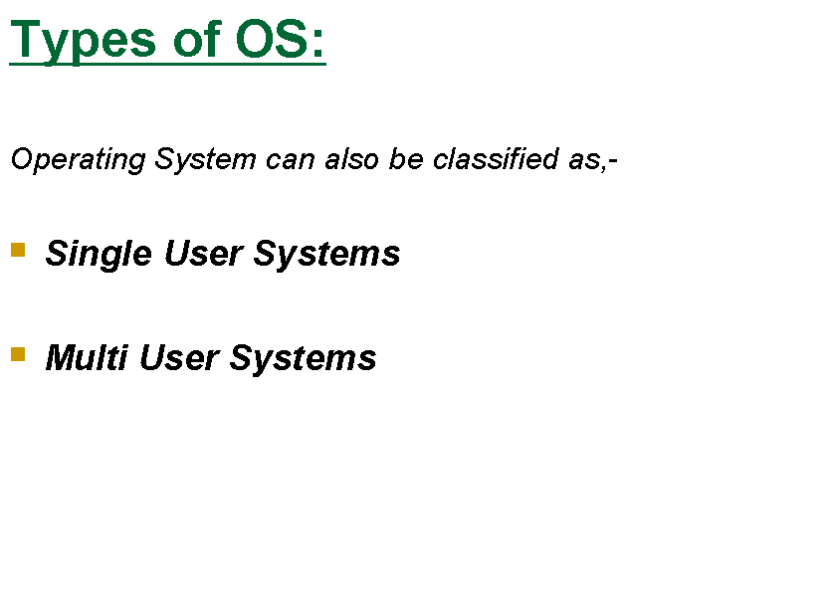

Slide 26
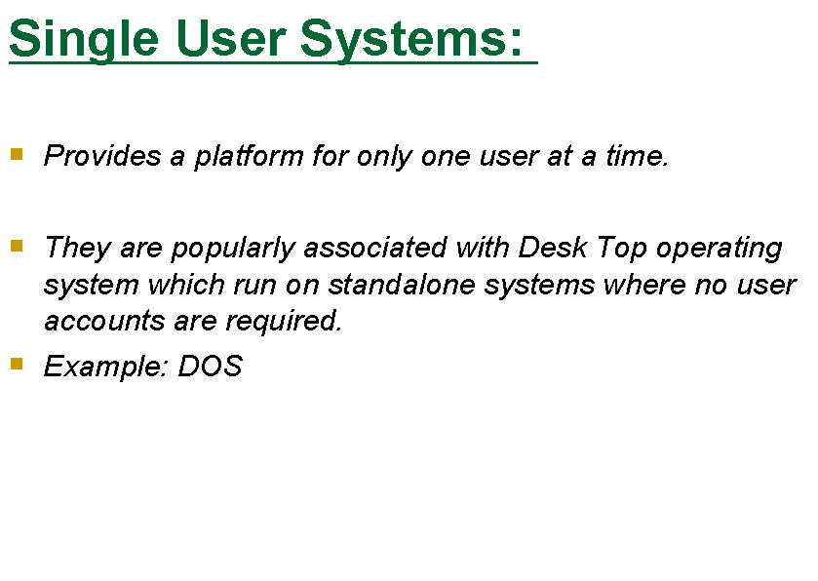

Slide 27
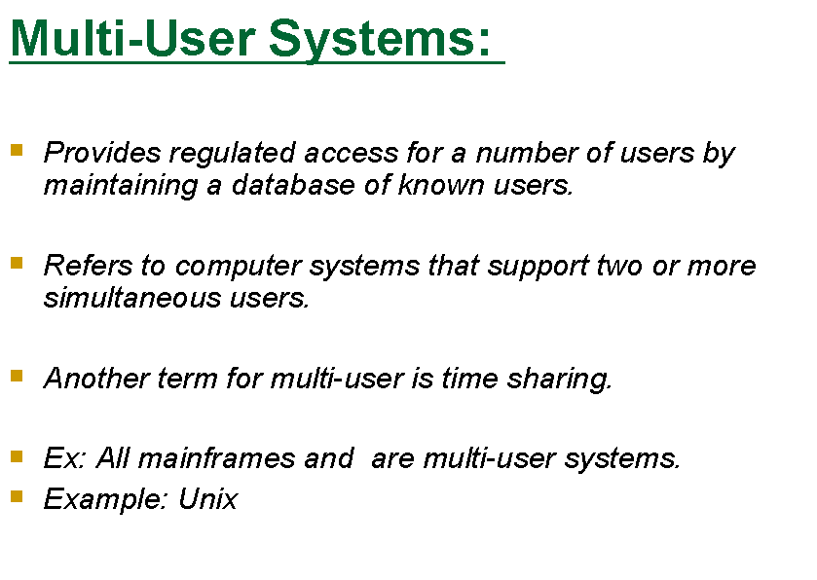

Slide 28
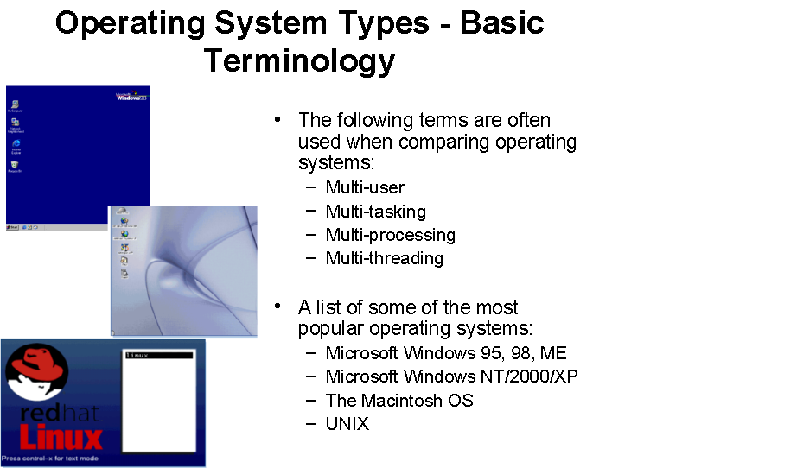

Slide 29
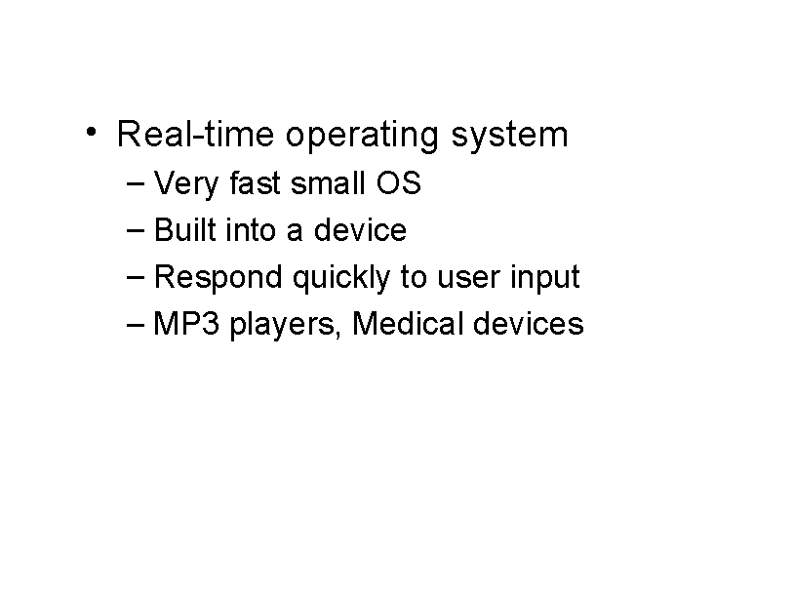

Slide 30
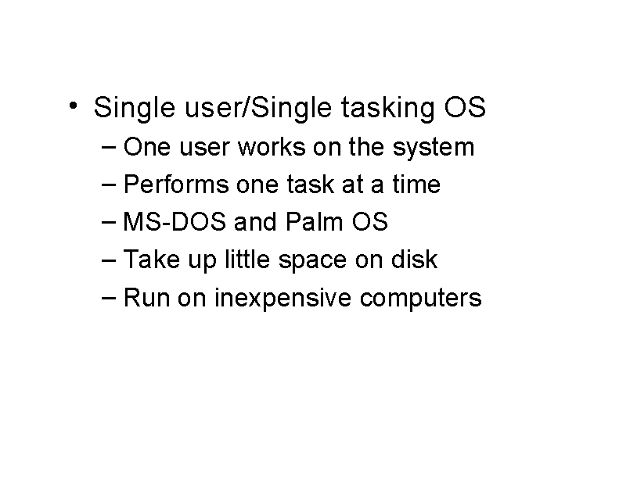

Slide 31
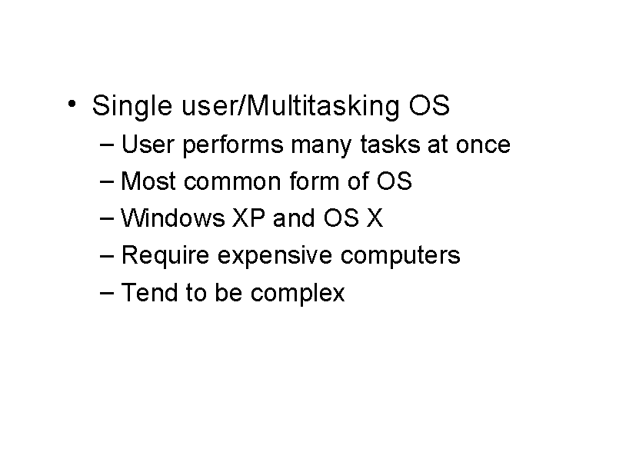

Slide 32
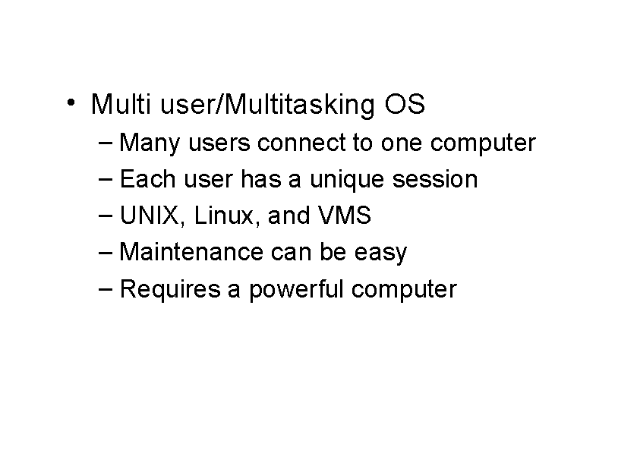

Slide 33
Types Of OS
Multiuser
Multiprocessing
Multitasking
Multithreading
Real Time

Slide 34
Different views of OS
Application view
Users view
System view(resource manager)
Implementation view

Slide 35
Operating system as Resource Manager
Resources available in the system : CPU, memory(RAM), file storage space, I/O devices(disk), files, printers
OS decides which program, for how much time to and after use it reclaims the resource.
Each program gets time and space with the resource

Slide 36
Multiple users/applications share the resources
Multiple users/applications share the resources bcoz devices are expensive
How to allocate them to specific programs (process, jobs)?
How to protect applications from one another?
How to provide fair and efficient access to resources?
How to operate and control the various I/O devices?

